Slide 1
Random Forests using Random Forests
Vishal Kotha, Arnav Jain
Quarter 2
Dr. Yilmaz’s Period 1 Machine Learning 2 Class
February 6, 2023

Slide 2
Overview
Statement/Project Goal
Description of Dataset
Attribute Selection/Preprocessing
Model Classifiers
Results and Analysis
Conclusion
Appendix/Sources

Slide 3

Our Goal
Improving on the current random forest model’s performance
Achieve a higher accuracy and learn more complex patterns in data
Keeping the computation time reasonable

Slide 4
Our Datasets
One dataset included data with 32 attributes and 72,983 instances of car information.
Heavy Class Imbalance (87.701% are one class)
The attributes included information about the car like the information pertaining to the auction it was sold at and characteristics specific to the car (like color)
The other dataset (iris) had four attributes and three classes (150 instances)
Uniformly distributed, smaller
Attributes contained flower characteristics (petal length & width + sepal length & width)

Slide 5
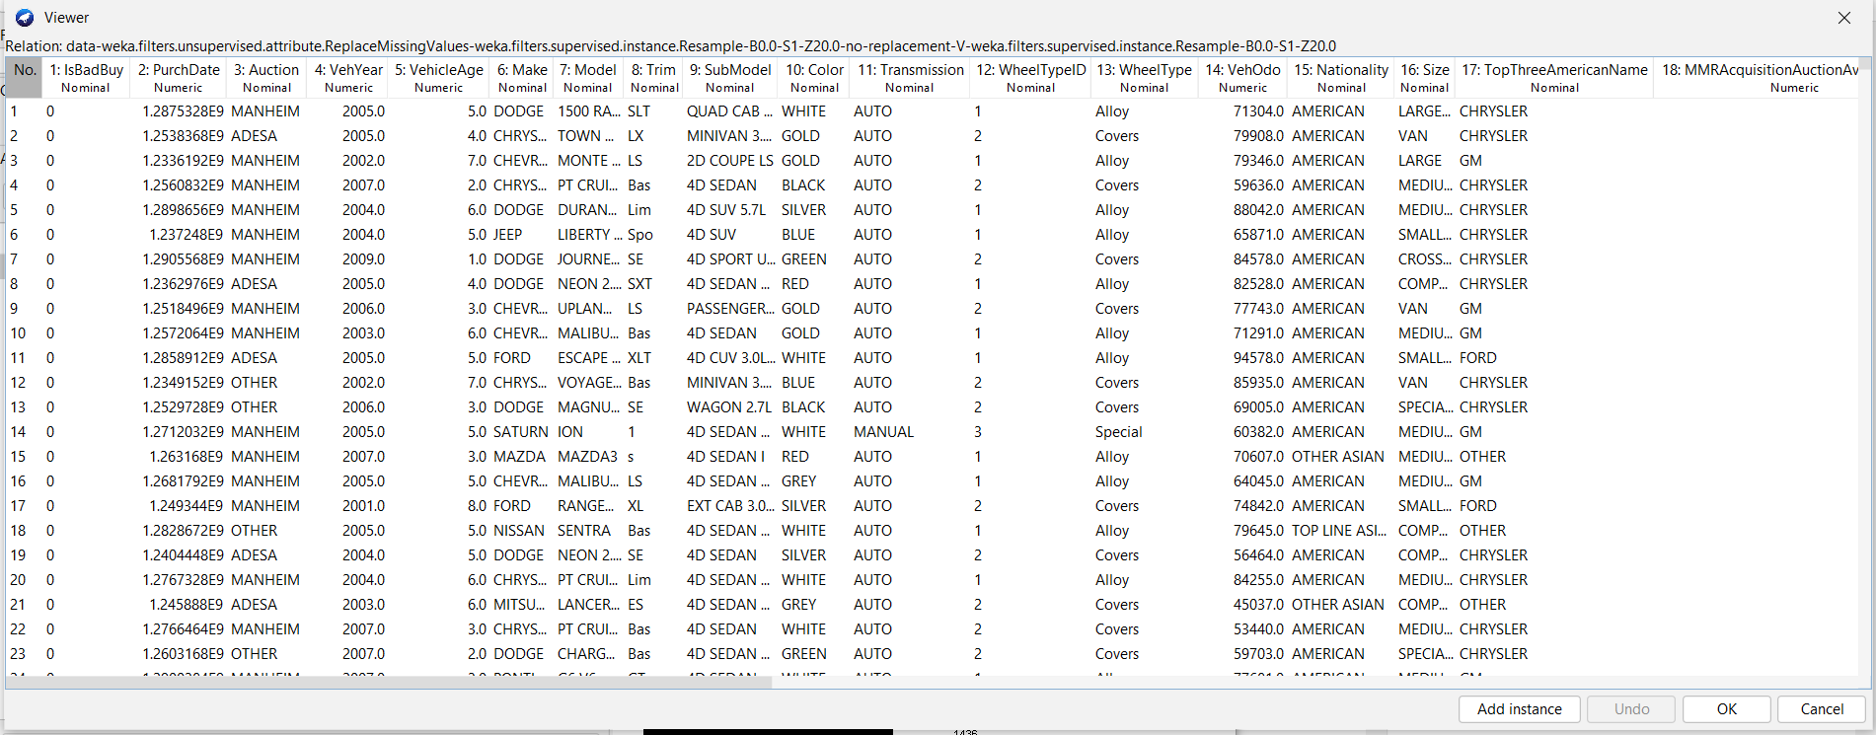
Data Snippet
Labels (isBadBuy) | 0 (“not a kick”) | 1 (“was a kick”)

Slide 6
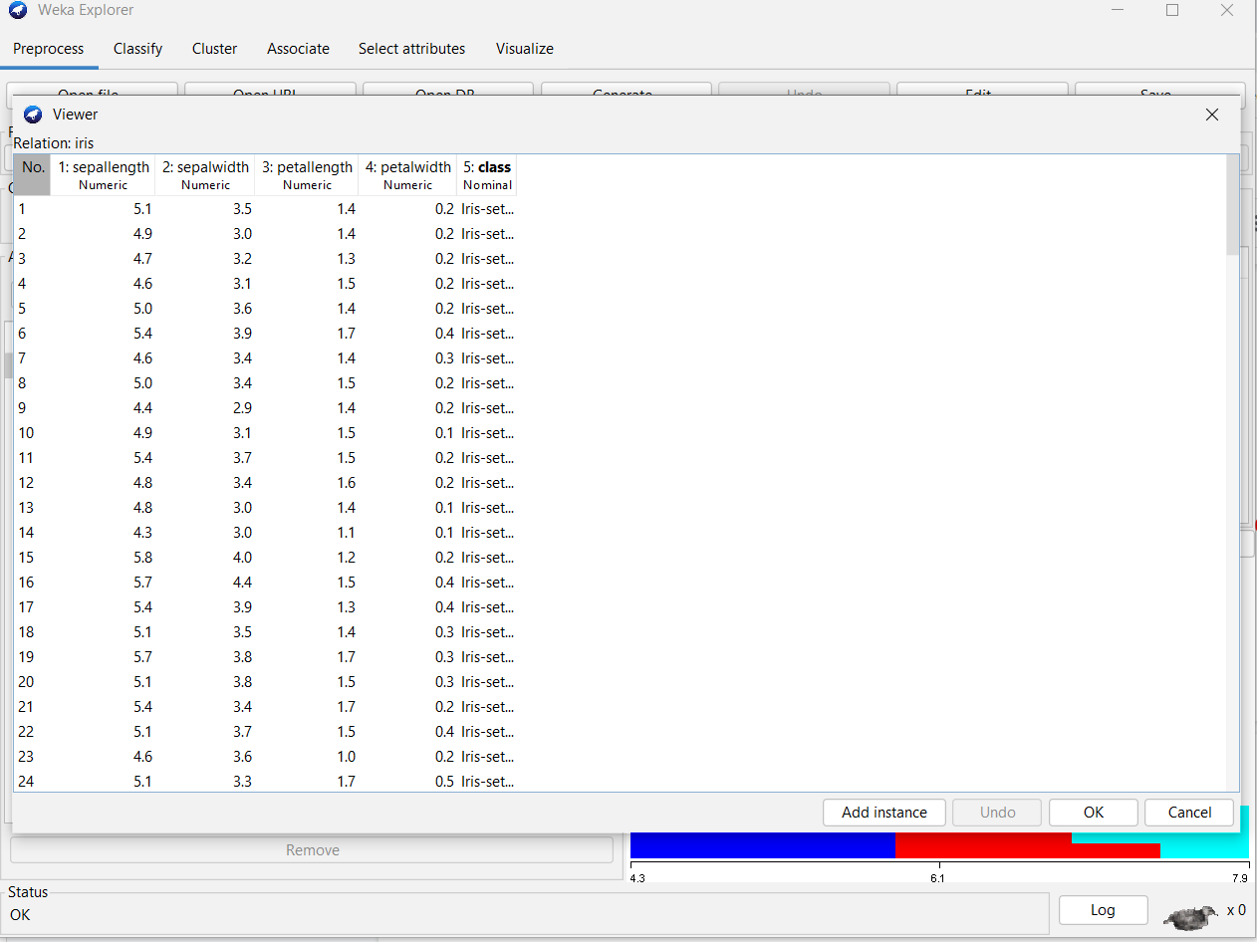
Data Snippet

Slide 7
Related Works
Breiman (Random Forests): Original random forest algorithm
Freund & Schapire (Boosting): Ensemble where each successive tree is tailored to instances the previous tree most incorrectly classified
Paul et. al. (Improved random forests for classification): Develop upper limit on number of trees & create reduced but informational attributes set
Quinlan (Induction of Decision Trees): Original decision tree algorithm
Robnik-Sikonja (Improving random forests): Use five different metrics (Gini Index for ⅕, etc.) & weight trees based on performance on similar instances in training dataset

Slide 8
Preprocessing/Modeling

Slide 9
Preprocessing Part 1
Kick Dataset
We converted all categorical columns to numerical and binned all numerical columns (3 equal width bins)
Randomly sampled without replacement (20%); 14,596 instances (12,801 versus 1,795)
80-20 training-testing split from this new sample
Training: 11,676 instances (10,240 versus 1,436)
Testing: 2,920 instances (2,561 versus 359

Slide 10
Preprocessing Part 2
Iris Dataset
80-20 training-testing split from original dataset (was small and uniformly distributed so no sampling needed)
150 instances (50 of each class)
Training Dataset: 40 instances of each class
Testing Dataset: 10 instances of each class

Slide 11
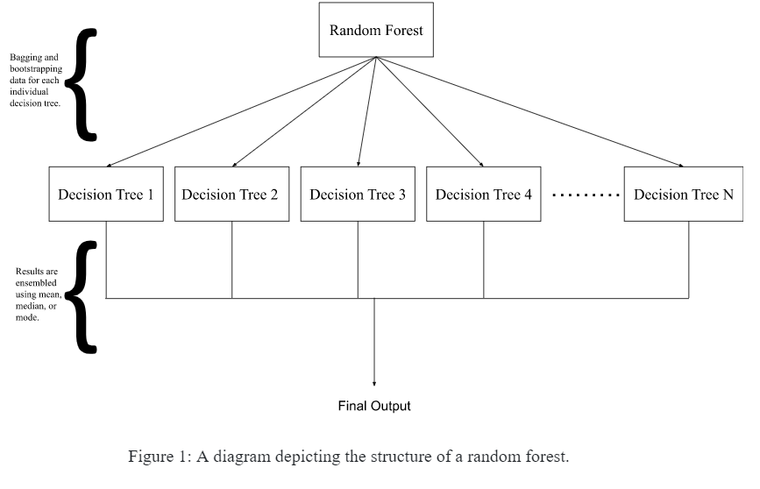
Random Forest

Slide 12
Our Model
Random forest of random forests until a certain depth (this is a parameter)
The splits at each level are still made based on information gain metric
Once that depth is reached, normal random forest using decision trees the rest of the way

Slide 13
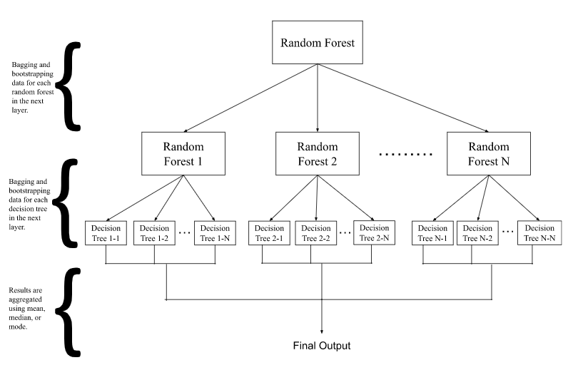
Our Model

Slide 14
Results and Analysis

Slide 15
Our Results
We have attached tables summarizing and comparing different performance metrics.
Model | Accuracy | TP Rate | FP Rate | ROC Area | Time Taken (s)
Random Forest (trees = 100) | 100.0% | 1.0 | 0.0 | 1.00 | 0.61937
AdaBoost | 100.0% | 1.0 | 0.0 | 1.00 | 0.1816
Random Forest of Random Forests (depth = 1) | 100.0% | 1.0 | 0.0 | 1.00 | 5.0684
Random Forest of Random Forests (depth = 2) | 100.0% | 1.0 | 0.0 | 1.00 | 25.3216
Table 1: Results on the iris dataset. Note: TP and FP are weighted

Slide 16
Our Results
Model | Accuracy | TP Rate | FP Rate | ROC Area | Time Taken (s)
Random Forest (trees = 100) | 87.4957% | 0.875 | 0.851 | 0.649 | 1.64
AdaBoost | 88.1507% | 0.877 | 0.877 | 0.679 | 5.59
Random Forest of Random Forests (depth = 1) | 88.8698% | 0.8913 | 0.8791 | 0.701 | 11.52
Random Forest of Randoms Forest (depth = 2) | 88.2642% | 0.8898 | 0.8801 | 0.694 | 40.18
Table 2: Results on the “kick” dataset. Note: TP and FP are weighted

Slide 17
Analysis/Conclusion
Showed similar results of 100% on the simple Iris dataset
Able to learn simple patterns on small datasets.
Improvement on “kick” dataset
Understands more complex patterns on large datasets
Doesn’t struggle with imbalance datasets as the other models do
This is seen by having a higher accuracy on the cars that are “kicks”
Speed
Slower speed overall
Can be optimized, similar to how sklearn optimizes the other models

Slide 18
Appendix/Sources

Slide 19
Sources/References
Data Source:
https://www.openml.org/search?type=data&sort=runs&id=41162&status=active
https://www.openml.org/search?type=data&sort=runs&id=61&status=active
Related Works:
https://drive.google.com/file/d/1cTOwboU8uI3wDB8iAeQGQaLYDTXfQESf/view
https://drive.google.com/file/d/1P4v9C4mJr2xIOUQcMw9PiZExe22V5ZSu/view
https://drive.google.com/file/d/11cJO7I8FZzp12ccL8PNBqm6NYDDt8kax/view
https://drive.google.com/file/d/1druopRWAh8sVPE7NEHU2xEa5r8D510pV/view
https://drive.google.com/file/d/1KAOhjOHES_oiZZmt-8FycPasEdrMLVrm/view

